Slide 1
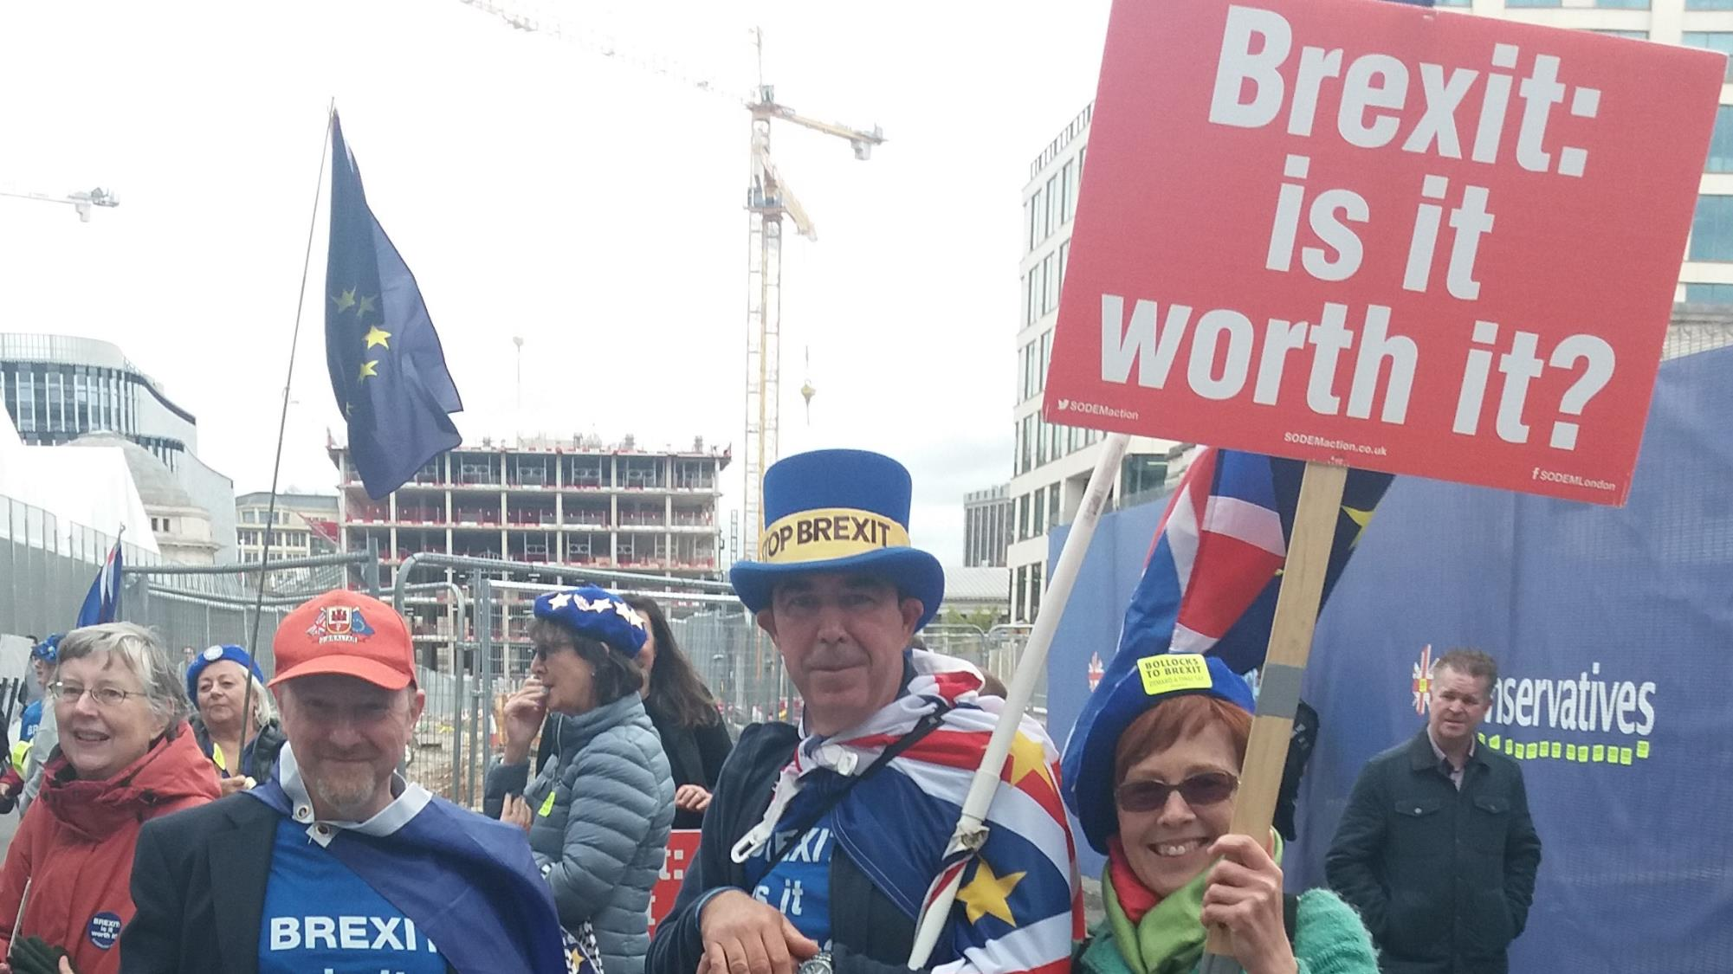

Sustaining Our Democracy
February 2019

Slide 2
Sustaining Our Democracy
“Meeting the challenges that our democracy faces, and reaching the many different groups that we all must serve, requires us to work collaboratively with a range of experts across the public, private and third sector.”
(Chloe Smith, Minister for the Constitution, 25 January 2019)

Slide 3
Sustaining Our Democracy
What Our Manifesto Said
“The United Kingdom Government has in the past tended to ‘devolve and forget’. This Conservative government will put that right. We want the UK Government to be a force for good across the whole country. So we will be an active government, in every part of the UK.” (p.31f)

Slide 4
Relationships between the UK government and people in every part of the UK
At a time when devolution has become an established feature of the UK constitution, the question of England’s place in the constitution needs urgently to be addressed. … The absence
of formal and effective inter-governmental relations mechanisms has been the missing part of the devolution settlement ever since devolution was established in 1998.

Slide 5
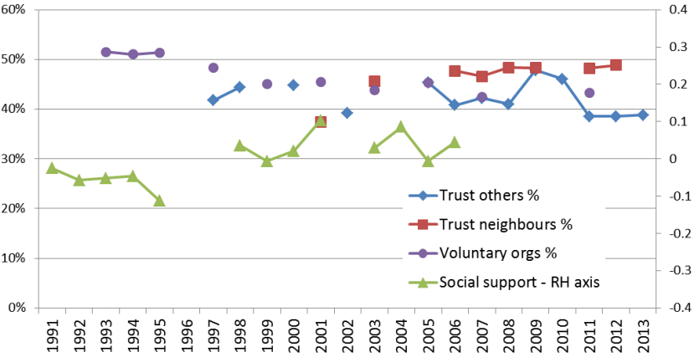
Public trust in civic institutions
Trends in four measures of social capital

Slide 6
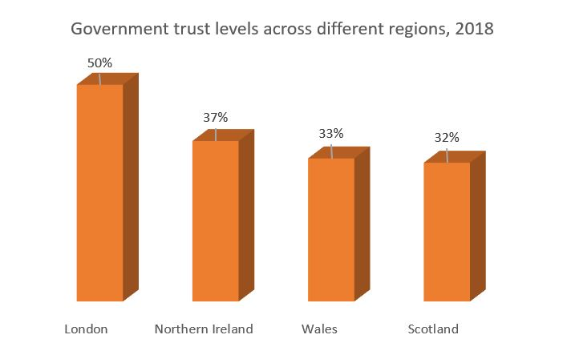
Public trust in civic institutions

Slide 7
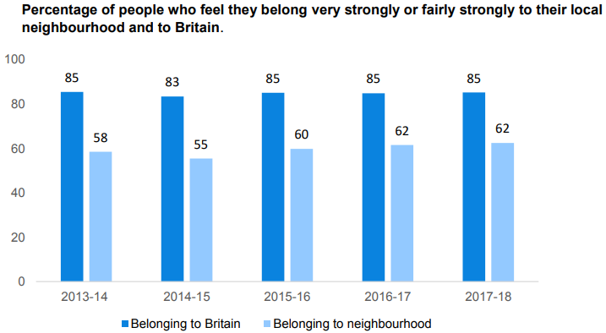
Community relationships and a sense of “ownership” over local areas

Slide 8
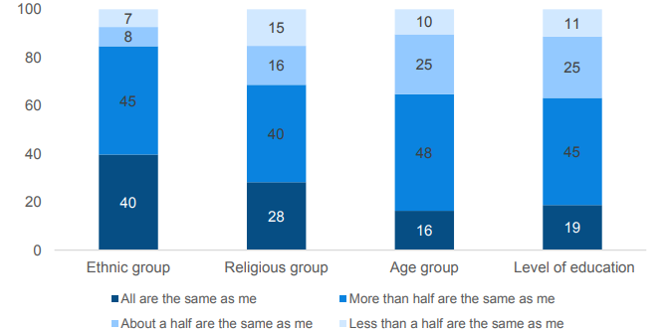
Community relationships and a sense of “ownership” over local areas

Slide 9
Greater participation, especially by young people, in our democracy
In the year 2017-18:
38% of people undertook some form of civic participation at least once
22% of people took part in formal volunteering at least once a month
38% of people volunteered formally at least once
25-34 year olds had the lowest rates of regular formal volunteering:
15%; those aged 65-74 had the highest rates: 29%

Slide 10
Conservative Party outreach to diverse communities
Over 50 link groups, such as LGBT+ Conservatives, Conservative Disability Group, and many “Friends of” groups, such as Conservative Friends of India and the recently established Conservative Friends of the Armed Forces.
43 roundtables in the last year with community groups across the North, Midlands and South—including African, Caribbean, Jewish,
Indian, Pakistani, Chinese and Tamil communities.
Record diversity of candidates in 2018 local elections.
Greater diversity amongst our Council Leaders.

Slide 11
Questions for discussion
How can we strengthen the Union, ensuring that the government serves people in every part of the UK?
How can we strengthen public trust in civic institutions?
What more can be done to promote positive community relationships and a sense of “ownership” over local areas?
How can we encourage more people, especially young
people, to participate in our democracy?
How can the Conservative Party more effectively
reach out to diverse communities?

Slide 12
Next steps
Deadline for submission of responses:
5 May by email to CPF.Papers@Conservatives.com
using the supplied response form
Next discussion paper:
Post-Brexit Economy
6 May 2019

